Slide 1
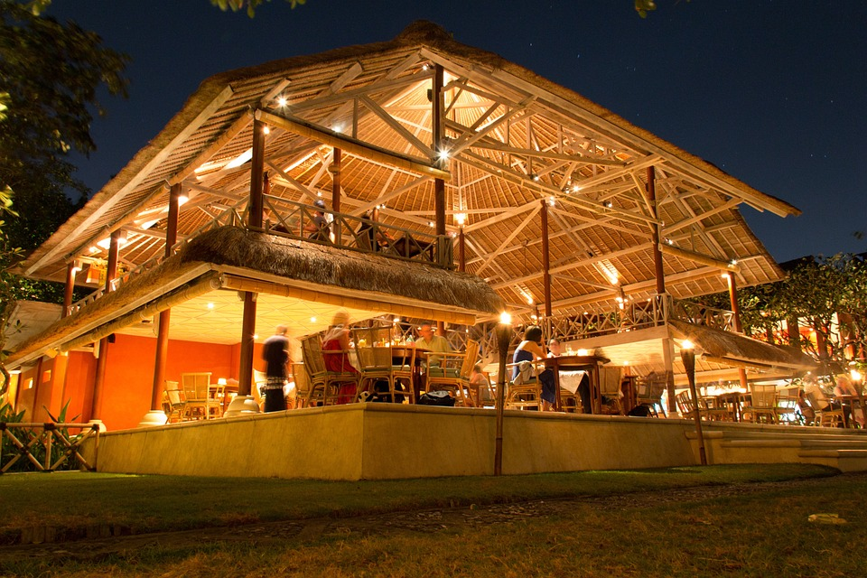
RESTAURANT DATA PRESENTATION
BY MAZIYA TABASSUM S

Slide 2

QUICK SCENARIO
1 million member ship in India
2 Government Companies, 2 private sectors
30k employees in private sector, 60k employees in Government sector
3 schools
Small Township

Slide 3

STAGES OF DATA COLLECTION , CLEANSING & PROCESSING and VISUALIZATIONS
1.DATA COLLECTION :
* observational, experimental, simulation, and derived.
* Surveys and Questionnaires.
* Update the data for analytics using EXCEL VBA.
2. CLEANSING & PROCESSING:
* Analyse the data and identify the errors.
* Cleanse the data by fixing the errors and replace the blanks cells to required cells.
* Apply formulas to clean data.
3. VISUALIZATIONS:
* Data visualization is the graphical representation of information and data.
* By using visual elements like charts and graphs.
* We can visualize the data from the Power BI.

Slide 4
RESTAURANT DASHBOARD

Slide 6


Slide 8
INSIGHT
1. Overall Analysis that the people from the township are not happy with the current hotel.
2. With the observation of the data 54% people prefer non-veg whereas 46% people prefer veg.
3. 90% of the people were shows interest in having a open roof restaurant.
4. 80% people shows interest for buffet.
5. 75% single people shows interest on having a food in the restaurant.

Slide 9


CONCLUSION
1. Start with restaurant with a seating capacity of 100 seats at a time.
2. Priority to be open for lunch and then extend to dinner depending on the popularity.
3. Start with Chinese cuisine for the first 3 months and will include the multi-cuisine.
4. Will make the Best Restaurant within 6 months.

